Slide 1

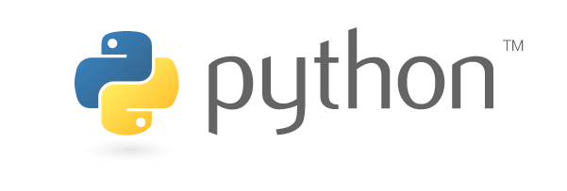
Introduction to Programming using Python
Ted Gibbons, Jonathan Goodson, Keith Hughitt
Fall 2013

Slide 2
Which language should you use?
Many!
BASH (including awk, sed, & grep)
PERL
Python
R
Different languages have different optimal uses
Each new language will be easier to learn!

Slide 3
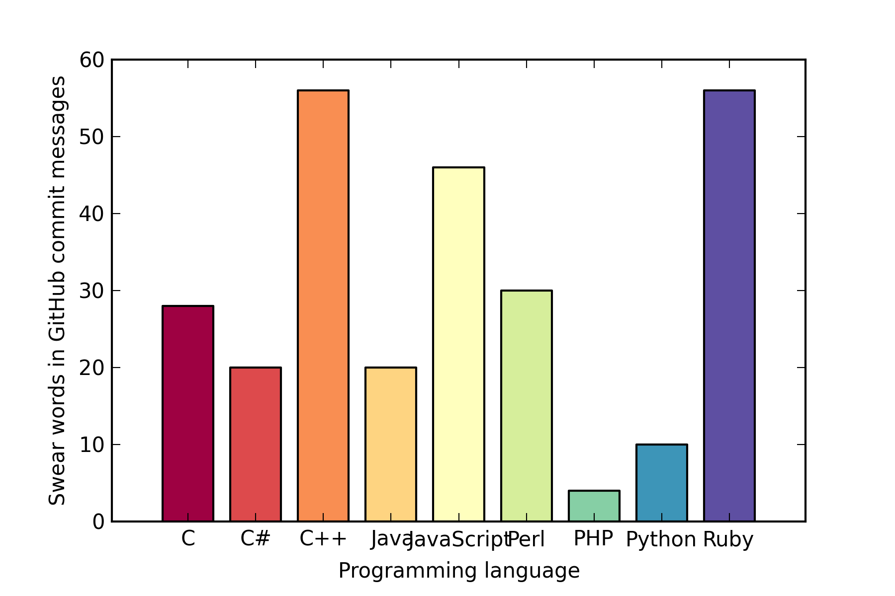
Why start with Python?
Profanity in GitHub commit messages vs. Programming Language
Data taken from: http://andrewvos.com/2011/02/21/amount-of-profanity-in-git-commit-messages-per-programming-language/
Plot generated using Python!

Slide 4
Python
R
#!/usr/bin/env python# Extend Python with NumPy array libraryimport numpy as np# Extend Python with matplotlib graphical librariesimport matplotlib.pyplot as pltimport matplotlib.cm as cm# Create data structures languages = ("C", "C#", "C++", "Java", "JavaScript", "Perl", "PHP", "Python", "Ruby") swear_words = np.array([28, 20, 56, 20, 46, 30, 4, 10, 56])
# Specify some pylab-specific parameters bar_width = 0.75 x_marks = np.arange(9)+bar_width colors = np.array(range(9))/float(8)# Create pylab object fig, ax = plt.subplots()# Add barchart layer and formatting to pylab object plt.bar(x_marks, swear_words,
color=cm.Spectral(colors), width=bar_width) plt.xticks(x_marks+bar_width/2, languages) plt.xlim(0, x_marks[-1]+bar_width*2)# Add labels plt.xlabel('Programming language') plt.ylabel('Swear words in GitHub commit messages')# Write plot to file plt.savefig("swear_words_pylab.png", figsize=(4, 6), dpi=300)
#!/usr/bin/env Rscript# Extend R with ggplot2 graphical library library(ggplot2)# Create data structureslanguages <- c("C", "C#", "C++", "Java", "JavaScript", "Perl", "PHP", "Python", "Ruby")swear_words <- c(28, 20, 56, 20, 46, 30, 4, 10, 56)df <- data.frame(language=languages, swear_words=swear_words)# Create ggplot objectgg <- ggplot(data=df, aes(language, weight=swear_words))# Add barchart layer and fomatting to ggplot objectgg <- gg + geom_bar(aes(fill=language), color=I("black"))gg <- gg + scale_fill_brewer(palette="Spectral", guide=FALSE)
# Add labelsgg <- gg + xlab("Programming language")gg <- gg + ylab("Swear words in GitHub commit messages")# Write plot to file png("swear_words_ggplot2.png", width=6, height=4, units="in", res=300)gg dev.off()

Slide 5
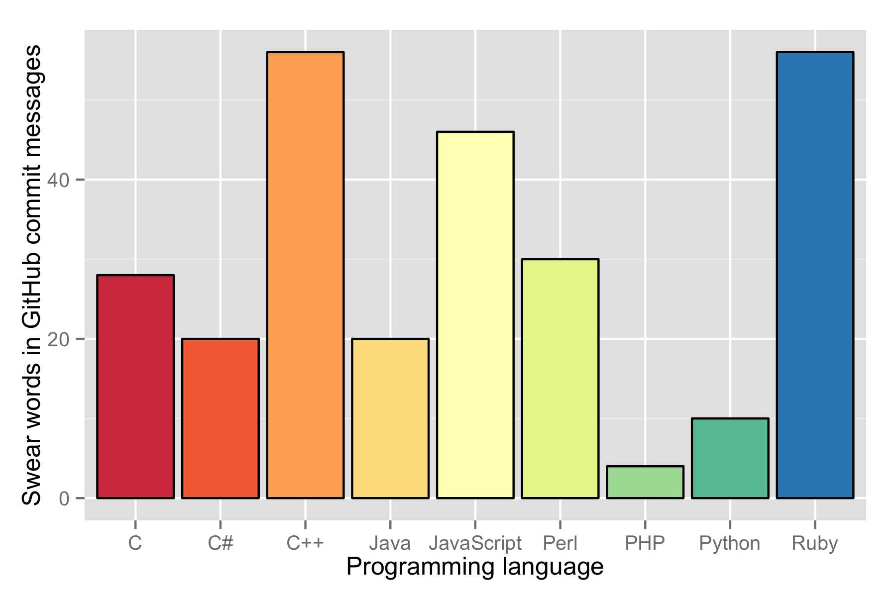
Keep learning!
Profanity in GitHub commit messages vs. Programming Language
Data taken from: http://andrewvos.com/2011/02/21/amount-of-profanity-in-git-commit-messages-per-programming-language/
Plot generated using R!

Slide 6
Why start with Python?
Readable!
Extensible!
Interpreted (or compiled!)
Scripted or Interactive!

Slide 7
Why start with Python?
Readable!
Extensible!
Interpreted (or compiled!)
Scripted or Interactive!

Slide 8
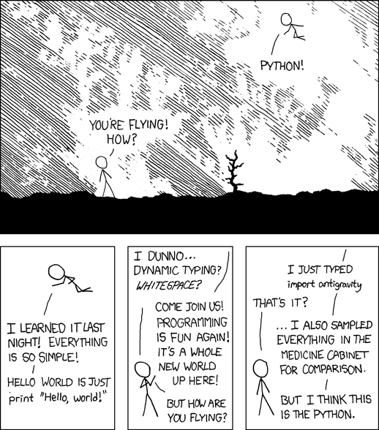
Interactive!
http://xkcd.com/353/

Slide 9
Readable!
counter = 0
for i in range(10):
counter += 1
print counter
Actual Python code:
Prints the numbers 1 through 10

Slide 10
Why start with Python?
Readable!
Extensible!
Interpreted (or compiled!)
Scripted or Interactive!

Slide 11
Extensible!
http://xkcd.com/353/

Slide 12
Python
R
#!/usr/bin/env python# Extend Python with NumPy array libraryimport numpy as np# Extend Python with matplotlib graphical librariesimport matplotlib.pyplot as pltimport matplotlib.cm as cm# Create data structures languages = ("C", "C#", "C++", "Java", "JavaScript", "Perl", "PHP", "Python", "Ruby") swear_words = np.array([28, 20, 56, 20, 46, 30, 4, 10, 56])
# Specify some pylab-specific parameters bar_width = 0.5 x_marks = np.arange(9)+bar_width colors = np.array(range(9))/float(8)# Create pylab object fig, ax = plt.subplots()# Add barchart layer and formatting to pylab object plt.bar(x_marks, swear_words,
color=cm.Spectral(colors), width=bar_width) plt.xticks(x_marks+bar_width/2, languages) plt.xlim(0, x_marks[-1]+bar_width*2)# Add labels plt.xlabel('Programming language') plt.ylabel('Swear words in GitHub commit messages')# Write plot to file plt.savefig("swear_words_pylab.png", figsize=(4, 6), dpi=300)
#!/usr/bin/env Rscript# Extend R with ggplot2 graphical library library(ggplot2)# Create data structureslanguages <- c("C", "C#", "C++", "Java", "JavaScript", "Perl", "PHP", "Python", "Ruby")swear_words <- c(28, 20, 56, 20, 46, 30, 4, 10, 56)df <- data.frame(language=languages, swear_words=swear_words)
# Create ggplot objectgg <- ggplot(data=df, aes(language, weight=swear_words))# Add barchart layer and fomatting to ggplot objectgg <- gg + geom_bar(aes(fill=language))gg <- gg + scale_fill_brewer(palette="Spectral", guide=FALSE)
# Add labelsgg <- gg + xlab("Programming language")gg <- gg + ylab("Swear words in GitHub commits")# Write plot to file png("swear_words_ggplot2.png", width=6, height=4, units="in", res=300)gg dev.off()

Slide 13
Why start with Python?
Readable!
Extensible!
Interpreted (or compiled!)
Scripted or Interactive!

Slide 14
Interpreted!
Header1
Header2
Header3
Library1
Library2
Library3
Source1
Source2
Source3
Script
Compile
Just execute it!
Object1
Object2
Object3
Link
Executable
Execute (finally)

Slide 15
Why start with Python?
Readable!
Extensible!
Interpreted (or compiled!)
Scripted or Interactive!

Slide 16
Development Environments
Live demo!
Notes:
Show them:
Interactive Python terminal
print “Hello, world!”
Text editor (TextWrangler)
Create hello_world.py
Run in BASH shell using ‘python’ command
Make executable, run w/o ‘python’ command
Copy into $PATH, cd to ~, run w/o specifying path
iPython terminal (new tab)
Tab completion
Terminal commands (!)
Show that these things don’t work in regular Python terminal

Slide 17
Development Environment
BASH
shell
Your favorite
text editor
(probably vim)
Interactive
Python
shell

Slide 18
Development Environment
IPython
BASH
shell
Your favorite
text editor
(probably vim)
Interactive
Python
shell

Slide 19
IPython “Magic” commands?
Unique to IPython (can not be used in normal Python scripts)
Enhance interaction with environment and provide additional tools for debugging scripts
All magic commands begin with %
%run
%paste
%quickref
%magic
%logstart

Slide 20
IDE: Spyder (via Anaconda)
Integrated Development Environment
Combines text editor with interactive terminal
Often includes additional “panes” containing one or more of the following:
Interactive help
Object explorer
Plots

Slide 21
IDE: Spyder (via Anaconda)
MOAR
Live demoS!
inconceivable!
Notes:
Spyder
Text editor w/ syntax highlighting
Tab completion
Terminal commands
(optional) Automatic iPython shell
Python part 1… (iPython notebook)

Slide 22
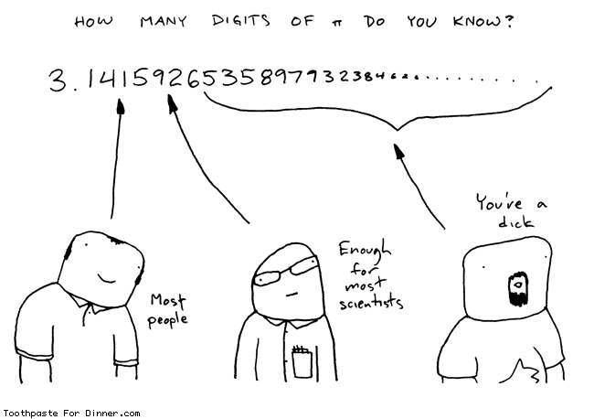
Printing Formatted Numbers
http://www.toothpastefordinner.com/031208/how-many-digits-of-pi-do-you-know.gif

Slide 26
Development Environment
In general, you will want some sort of text editor and...
Interactive Python shell
Allows code to be executed as it is typed
Stores variables in memory
Good for testing
IP[y]thon [!]
All the features of a normal interactive Python shell, plus…
Tab-completion!
Interactive debugging!
Easy access to underlying shell commands!
“Magic” commands!

Slide 27
Which Python version?
2.7
Most likely to be available by default
Supports most libraries
Last version of 2.x
3.2
Faster
More memory efficient
(slightly) More intuitive
Supports relatively few libraries
Won’t appear on major platforms by default until 2014

